Slide 1
Copyright © 2015 Inter-American Development Bank. This work is licensed under a Creative Commons IGO 3.0 Attribution-Non Commercial-No Derivatives (CC-IGO BY-NC-ND 3.0 IGO) license (http://creativecommons.org/licenses/by-nc-nd/3.0/igo/legalcode) and may be reproduced with attribution to the IDB and for any non-commercial purpose. No derivative work is allowed.
Any dispute related to the use of the works of the IDB that cannot be settled amicably shall be submitted to arbitration pursuant to the UNCITRAL rules. The use of the IDB’s name for any purpose other than for attribution, and the use of IDB’s logo shall be subject to a separate written license agreement between the IDB and the user and is not authorized as part of this CC-IGO license.
Note that link provided above includes additional terms and conditions of the license.
The opinions expressed in this publication are those of the authors and do not necessarily reflect the views of the Inter-American Development Bank, its Board of Directors, or the countries they represent.

Slide 2
Household Surveys
SECTION 8
AGRICULTURAL ACTIVITIES
Applicable to all households that have an independent farmer
THE PERSON MOST INFORMED ABOUT THE AGRICULTURAL ACTIVITIES OF THE HOUSEHOLD ANSWERS

Slide 3
SECTION 8: AGRICULTURAL ACTIVITIES
OBJECTIVES
Similar to section 7, this section seeks to find out details on the agricultural activities done by the members of the household in non-salaried form.
PERSONS TO BE SURVEYED
This section must be answered by the most informed person for each one of the non-salaried agricultural activities done by the members of the household.

Slide 4
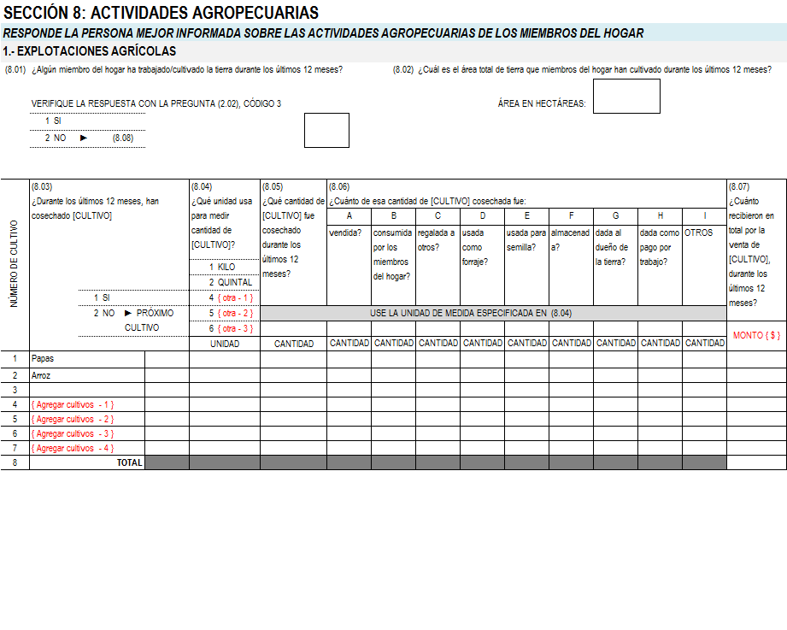
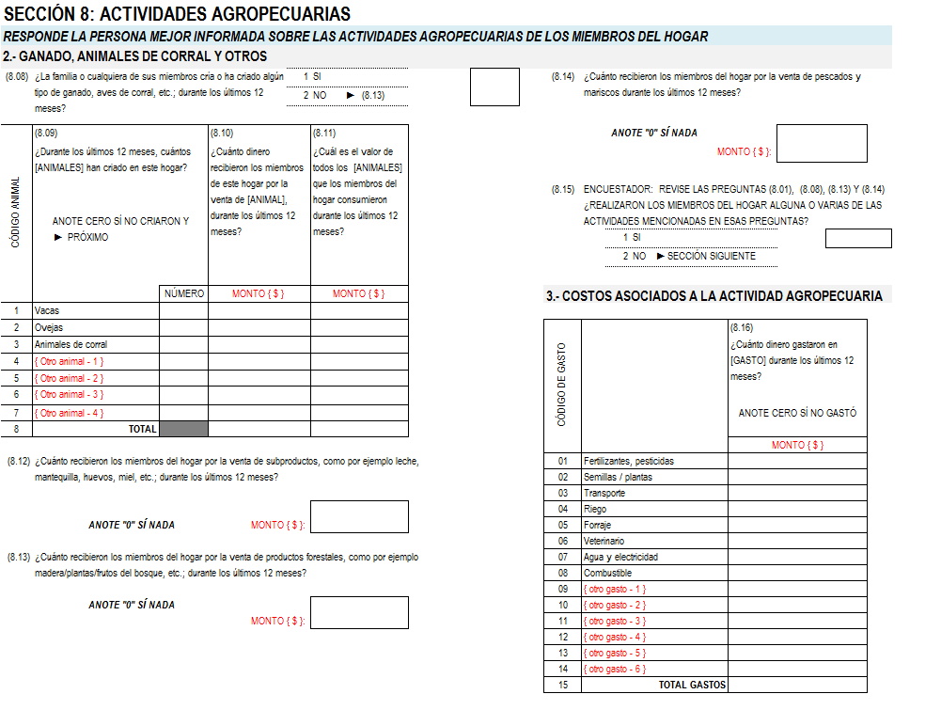
SECTION 8: AGRICULTURAL ACTIVITIES

Slide 5
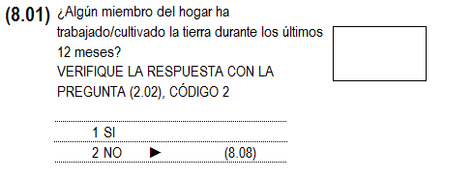
SECTION 8: AGRICULTURAL ACTIVITIES
Check with section 2; do not forget that despite the answer given the interviewee must at least answer questions 8.08, 8.13 and 8.14

Slide 6
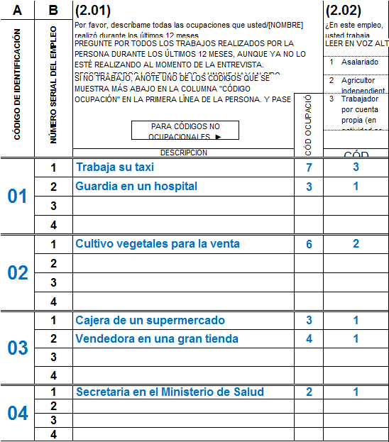
SECTION 8: AGRICULTURAL ACTIVITIES
In this case, there is a cultivation of land activity, then the answer to (8.01) must be 1: YES
1

Slide 7
SECTION 8: AGRICULTURAL ACTIVITIES
If they have more than one piece of land, you must register the total surface area.
Remember that 1 hectare corresponds to 10,000 square meters.
The piece of land can belong to a member of the household or not, what is important is whether the household has exploited it during the past 12 months.

Slide 8
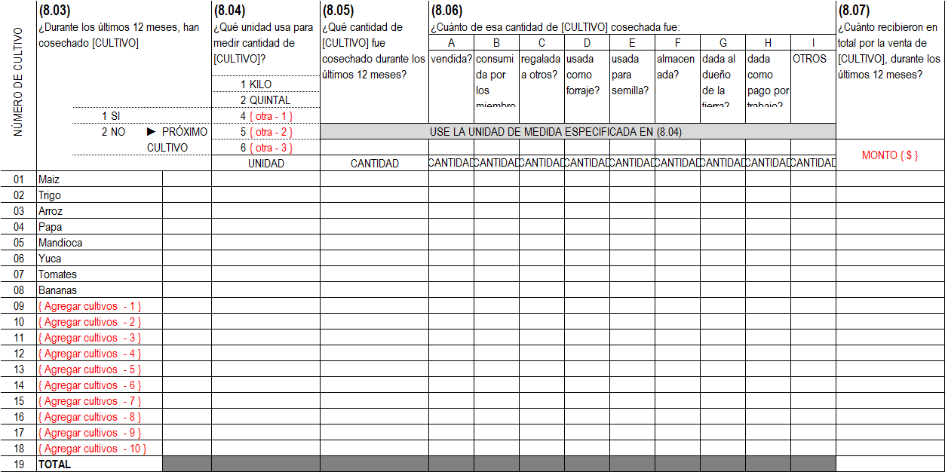
SECTION 8: AGRICULTURAL ACTIVITIES

Slide 9
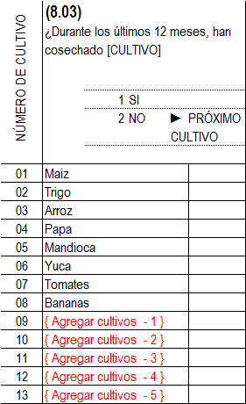
SECTION 8: AGRICULTURAL ACTIVITIES

Slide 10
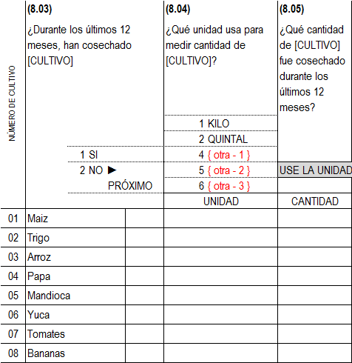
SECTION 8: AGRICULTURAL ACTIVITIES
Ask question (8.03) for all the crops first.
Once you finish with the list, ask questions (8.04) – (8.07) for those crops that were harvested

Slide 11
SECTION 8: AGRICULTURAL ACTIVITIES
You:
Line 1:
During the past 12 months, have you harvested Corn?
Interviewee:
No
You:
Line 2:
During the past 12 months, have you harvested Wheat?
Interviewee:
No
2
2
You:
Line 3:
During the past 12 months, have you harvested Rice?
2
Interviewee:
No

Slide 12
SECTION 8: AGRICULTURAL ACTIVITIES
You:
Line 4:
During the past 12 months, have you harvested Potato?
Interviewee:
YES
You:
Line 5:
During the past 12 months, have you harvested Cassava?
Interviewee:
YES
2
2
You:
Line 6:
During the past 12 months, have you harvested Yucca?
2
1
1
2
Interviewee:
No
1
2

Slide 13
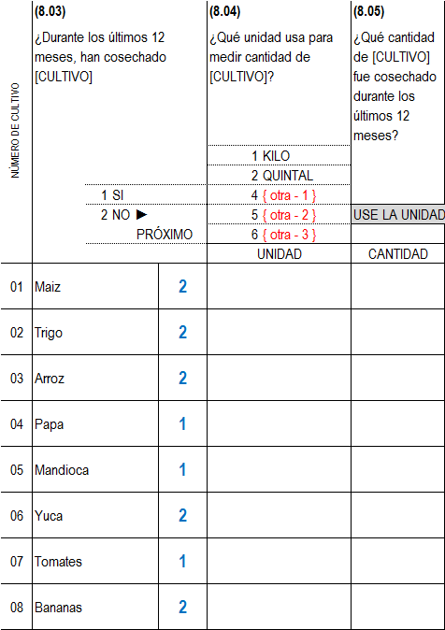
SECTION 8: AGRICULTURAL ACTIVITIES
Now proceed horizontally for the harvested crops:

Slide 14
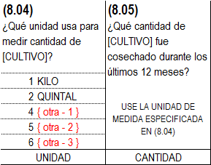
SECTION 8: AGRICULTURAL ACTIVITIES

Slide 15
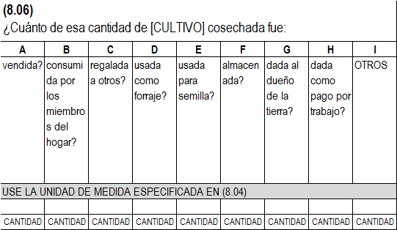
SECTION 8: AGRICULTURAL ACTIVITIES

Slide 16
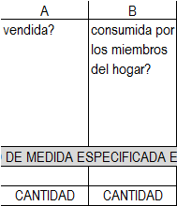
SECTION 8: AGRICULTURAL ACTIVITIES

Slide 17
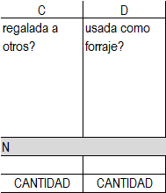
SECTION 8: AGRICULTURAL ACTIVITIES

Slide 18
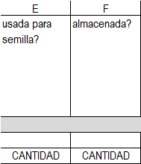
SECTION 8: AGRICULTURAL ACTIVITIES

Slide 19
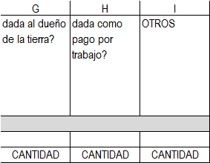
SECTION 8: AGRICULTURAL ACTIVITIES

Slide 20
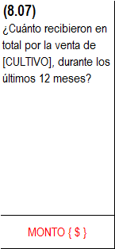
SECTION 8: AGRICULTURAL ACTIVITIES

Slide 21
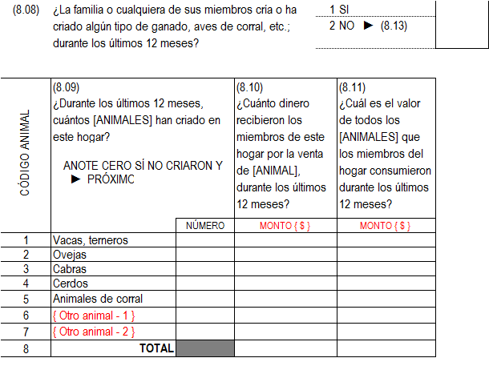
SECTION 8: AGRICULTURAL ACTIVITIES

Slide 22
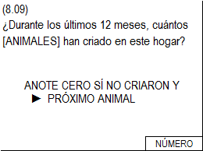
SECTION 8: AGRICULTURAL ACTIVITIES

Slide 23
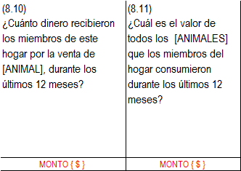
SECTION 8: AGRICULTURAL ACTIVITIES
(8.11)
It’s not easy to answer this question, but you can help the interviewee like this:
“If you had bought at the market all the (ANIMALS) that your household consumed during the past 2 months, how much would you have paid?”
The same is valid for the questions that come up next

Slide 24
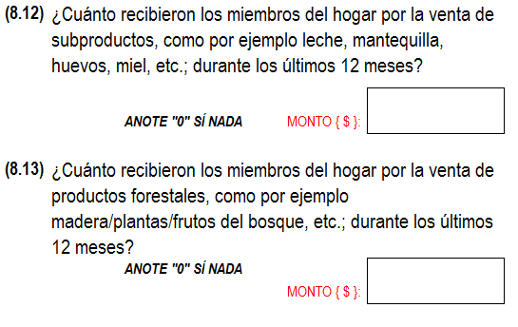
SECTION 8: AGRICULTURAL ACTIVITIES

Slide 25
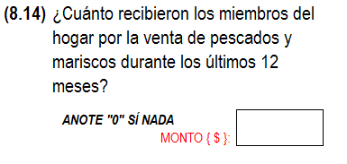
SECTION 8: AGRICULTURAL ACTIVITIES

Slide 26
SECTION 8: AGRICULTURAL ACTIVITIES

Slide 27
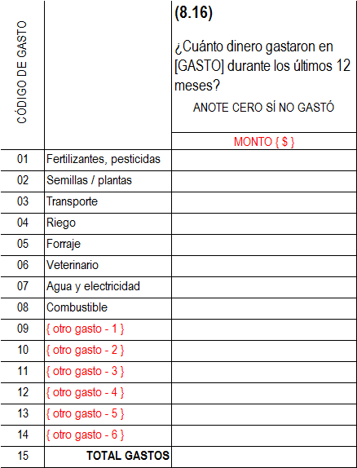
SECTION 8: AGRICULTURAL ACTIVITIES

Slide 28
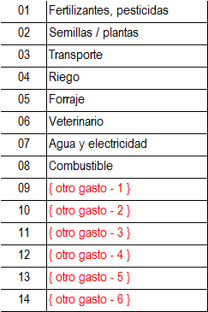
SECTION 8: AGRICULTURAL ACTIVITIES

Slide 29
END OF SECTION 8

