Slide 1
Copyright © 2015 Inter-American Development Bank. This work is licensed under a Creative Commons IGO 3.0 Attribution-Non Commercial-No Derivatives (CC-IGO BY-NC-ND 3.0 IGO) license (http://creativecommons.org/licenses/by-nc-nd/3.0/igo/legalcode) and may be reproduced with attribution to the IDB and for any non-commercial purpose. No derivative work is allowed.
Any dispute related to the use of the works of the IDB that cannot be settled amicably shall be submitted to arbitration pursuant to the UNCITRAL rules. The use of the IDB’s name for any purpose other than for attribution, and the use of IDB’s logo shall be subject to a separate written license agreement between the IDB and the user and is not authorized as part of this CC-IGO license.
Note that link provided above includes additional terms and conditions of the license.
The opinions expressed in this publication are those of the authors and do not necessarily reflect the views of the Inter-American Development Bank, its Board of Directors, or the countries they represent.

Slide 2
Household Surveys
SECTION 11
NON-FOOD SPENDING INSIDE AND OUTSIDE THE HOUSEHOLD
HEAD OF HOUSEHOLD OR PARTNER ANSWERS

Slide 3
SECTION 11: NON-FOOD SPENDING INSIDE AND OUTSIDE THE HOUSEHOLD
OBJECTIVES
This section seeks to find out the non-food expenditures of the members of the household, for the purchase of services, products, or objects to be used both inside and outside the household for some of the members of the household, taking into consideration the consumption of different items during three reference periods:
a month
three months
twelve months

Slide 4
SECTION 11: NON-FOOD SPENDING INSIDE AND OUTSIDE THE HOUSEHOLD
PERSONS TO BE SURVEYED
This section must be answered by the head of household or their partner. Don’t forget that the respondent can ask other members of the household for details on their spending.

Slide 5
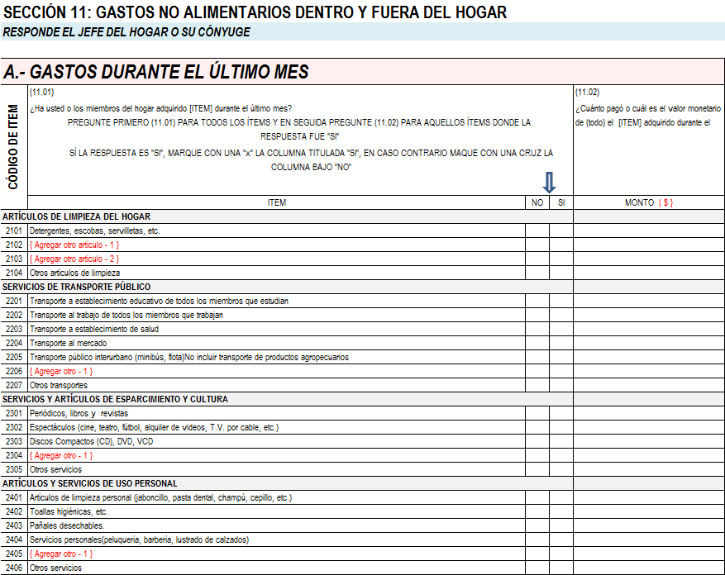
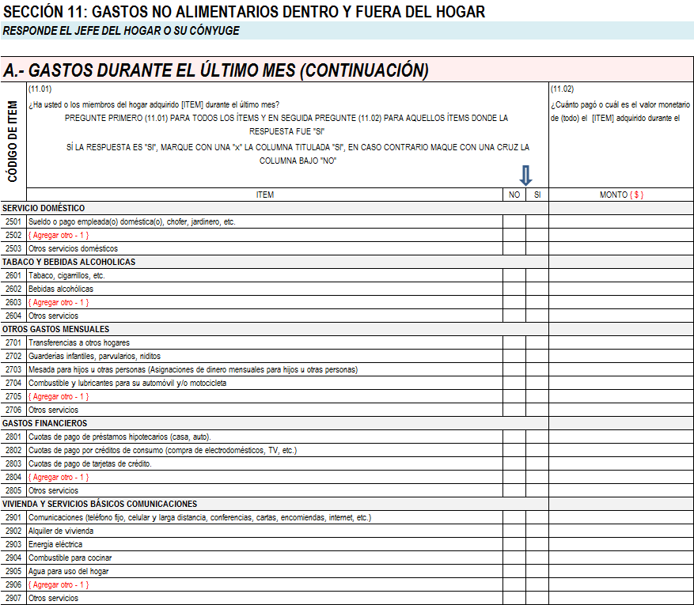
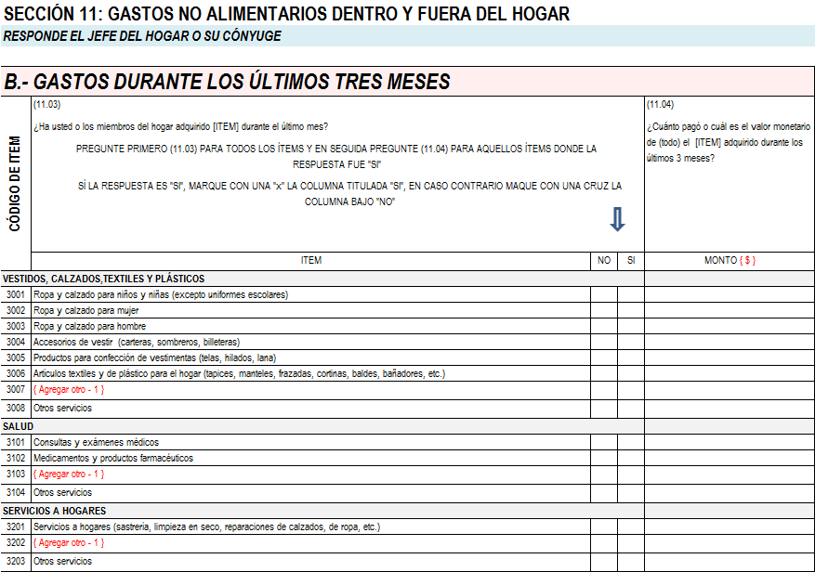
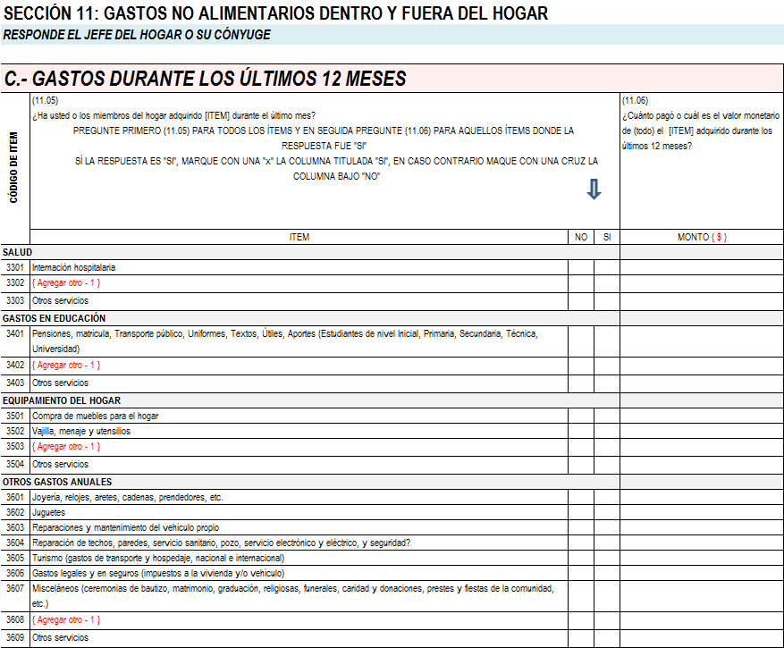
SECTION 11: NON-FOOD SPENDING INSIDE AND OUTSIDE THE HOUSEHOLD

Slide 6
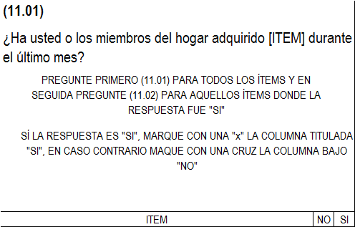
SECTION 11: NON-FOOD SPENDING INSIDE AND OUTSIDE THE HOUSEHOLD
A.- SPENDING DURING THE LAST MONTH

Slide 7
SECTION 11: NON-FOOD SPENDING INSIDE AND OUTSIDE THE HOUSEHOLD
The mechanics are exactly the same as the ones used in Section 10.
First ask the first question for all the items
Afterwards ask the second question for those items that were acquired

Slide 8
SECTION 11: NON-FOOD SPENDING INSIDE AND OUTSIDE THE HOUSEHOLD
Take special care that the respondent understands the reference period; as the first table is for one month, the second is for three months and the last, 12 months

Slide 9
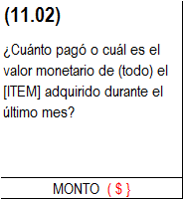
SECTION 11: NON-FOOD SPENDING INSIDE AND OUTSIDE THE HOUSEHOLD
A.- SPENDING DURING THE LAST MONTH

Slide 10
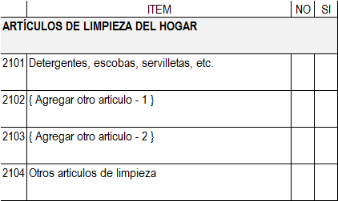
SECTION 11: NON-FOOD SPENDING INSIDE AND OUTSIDE THE HOUSEHOLD
A.- SPENDING DURING THE LAST MONTH

Slide 11
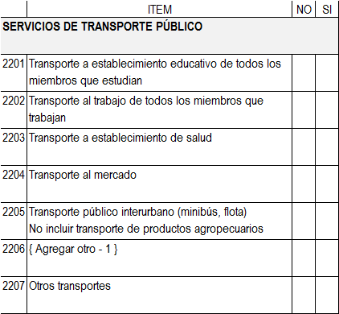
SECTION 11: NON-FOOD SPENDING INSIDE AND OUTSIDE THE HOUSEHOLD
A.- SPENDING DURING THE LAST MONTH

Slide 12
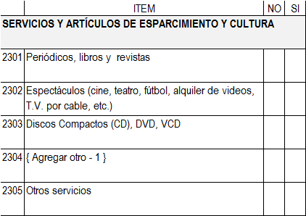
SECTION 11: NON-FOOD SPENDING INSIDE AND OUTSIDE THE HOUSEHOLD
A.- SPENDING DURING THE LAST MONTH

Slide 13
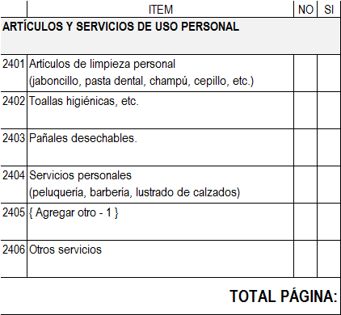
SECTION 11: NON-FOOD SPENDING INSIDE AND OUTSIDE THE HOUSEHOLD
A.- SPENDING DURING THE LAST MONTH

Slide 14
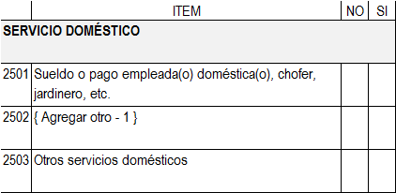
SECTION 11: NON-FOOD SPENDING INSIDE AND OUTSIDE THE HOUSEHOLD
A.- SPENDING DURING THE LAST MONTH

Slide 15
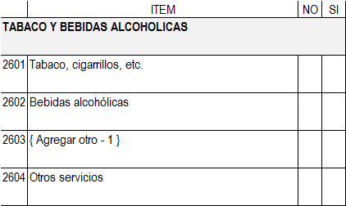
SECTION 11: NON-FOOD SPENDING INSIDE AND OUTSIDE THE HOUSEHOLD
A.- SPENDING DURING THE LAST MONTH

Slide 16
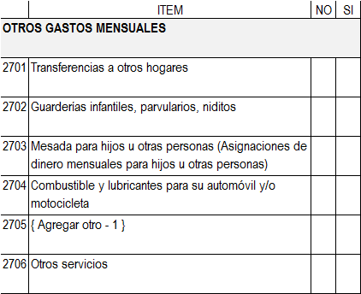
SECTION 11: NON-FOOD SPENDING INSIDE AND OUTSIDE THE HOUSEHOLD
A.- SPENDING DURING THE LAST MONTH

Slide 17
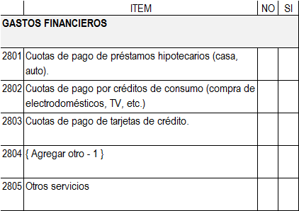
SECTION 11: NON-FOOD SPENDING INSIDE AND OUTSIDE THE HOUSEHOLD
A.- SPENDING DURING THE LAST MONTH

Slide 18
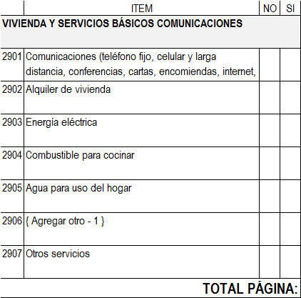
SECTION 11: NON-FOOD SPENDING INSIDE AND OUTSIDE THE HOUSEHOLD
A.- SPENDING DURING THE LAST MONTH

Slide 19
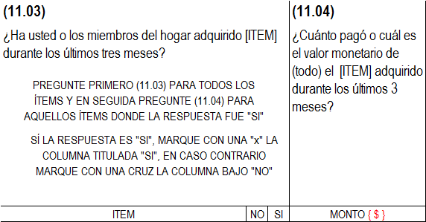
SECTION 11: NON-FOOD SPENDING INSIDE AND OUTSIDE THE HOUSEHOLD
B.- SPENDING DURING THE LAST THREE MONTHS

Slide 20
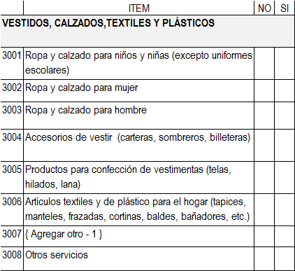
SECTION 11: NON-FOOD SPENDING INSIDE AND OUTSIDE THE HOUSEHOLD
B.- SPENDING DURING THE LAST THREE MONTHS

Slide 21
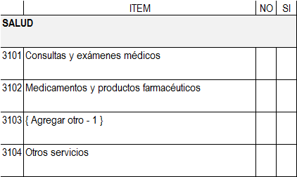
SECTION 11: NON-FOOD SPENDING INSIDE AND OUTSIDE THE HOUSEHOLD
B.- SPENDING DURING THE LAST THREE MONTHS

Slide 22
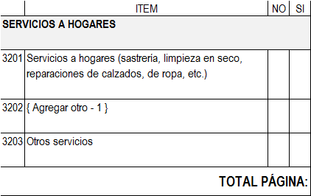
SECTION 11: NON-FOOD SPENDING INSIDE AND OUTSIDE THE HOUSEHOLD
B.- SPENDING DURING THE LAST THREE MONTHS

Slide 23
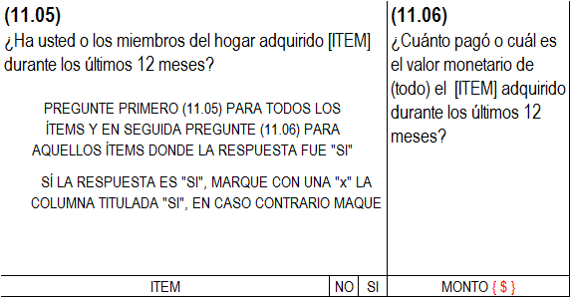
SECTION 11: NON-FOOD SPENDING INSIDE AND OUTSIDE THE HOUSEHOLD
C.- SPENDING DURING THE LAST 12 MONTHS

Slide 24
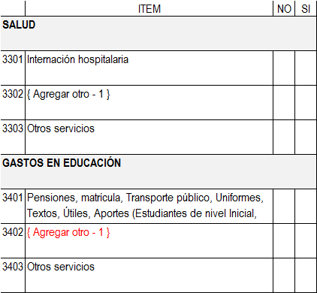
SECTION 11: NON-FOOD SPENDING INSIDE AND OUTSIDE THE HOUSEHOLD
C.- SPENDING DURING THE LAST 12 MONTHS

Slide 25
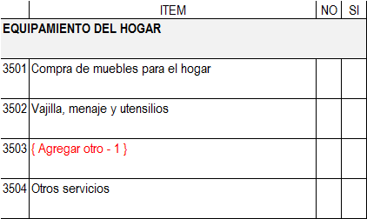
SECTION 11: NON-FOOD SPENDING INSIDE AND OUTSIDE THE HOUSEHOLD
C.- SPENDING DURING THE LAST 12 MONTHS

Slide 26
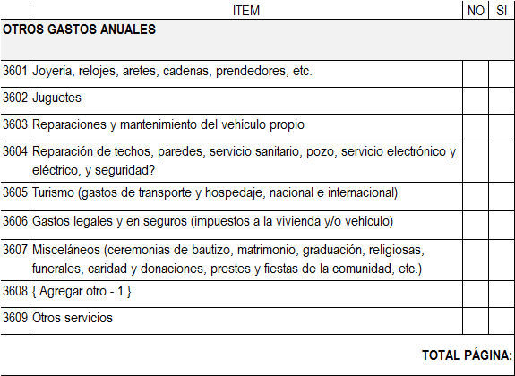
SECTION 11: NON-FOOD SPENDING INSIDE AND OUTSIDE THE HOUSEHOLD
C.- SPENDING DURING THE LAST 12 MONTHS

Slide 27
END OF SECTION 11

