Slide 1
AEIR 2016 Theme: What Drives Different Types of FDI in Asia?
Fahad Khan
Economist, ERCI
Asian Development Bank
XIV Annual Conference of the Euro-Latin Study—Network on Integration and Trade Paris, France | 21 October 2016
Acknowledgement: Based on background papers by Professor Hyun-Hoon Lee (Kangwon National University), Professor Natalia Ramondo (UC San Diego), Professor Julien Chaisse (City University of Hong Kong), and Professor Rodolphe Desbordes (University of Strathclyde), and in-house ADB research

Slide 2
Outline
Introduction
Patterns and Trends of FDI
Determinants of FDI
Key Messages

Slide 3
Introduction

Slide 4
Context
Empirical evidence on the beneficial impact of FDI is mixed; depends on the ‘type of FDI’ and the country context
Greenfield investment versus M&A
Horizontal versus vertical FDI
Sectoral: Natural resource, manufacturing, or services
Source economies
Drivers/determinants of FDI to promote trade and investment most conducive for DMCs

Slide 5
Research Questions
What is the role of comparative advantage, institutions, integration, and other policy factors in driving FDI inflows
Adopted firm-level analysis, tracing ultimate source of investment activity
Focus on MNC mode of entry and motivation
As an increasingly employed instrument of policy, the efficacy of International Investment Agreements in driving FDI?

Slide 6
Official sources of bilateral FDI data based on BOP/IIP definition
Database | Flows |  | Stock |  | Country coverage | Period coverage
 | IN | OUT | IN | OUT
UNCTAD | ✓ | ✓ | ✓ | ✓ | 206 economies, all available partners | 2001-2012
ASEAN Secretariat | ✓ |  |  |  | 10 ASEAN, major partners | 2001-2015
OECD | ✓ |  | ✓ |  | 34 OECD, all available partners | 1985-2012
Eurostat | ✓ | ✓ | ✓ | ✓ | 28 EU members, all partners | 2001-2014
IMF CDIS |  |  | ✓ | ✓ | 90 reporter–economies | 2009-2013
National sources | depends on country data source; data available for AUS, JPN, KOR, GEO, IND, TAP, PRC, HKG, US, MEX, CHL, COL
Notes:
National sources

Slide 7
Methodology to generate complete bilateral FDI inflow data (2001-2015)
Base data from UNCTAD for 2001-2012
ASEAN data up to 2015 from ASEAN Secretariat
EU data up to 2014 from EUROSTAT
National Source data, where available up to 2015
Extrapolation of missing data for 2013-2015, using reporter’s average bilateral FDI as % of GDP for 2010-2012

Slide 8
New Data Sources
Mode of entry
Greenfield: FDi Markets, Financial Times
Sectorial coverage: 39 sectors and 272 sub-sectors using its own classification
M&As: Zephyr, Bureau Van Dijk
Sectoral coverage: 2-6 digit NAICS 2012. Correct data to trace ultimate acquirer through Orbis.
Match, merge and aggregate up to primary, manufacturing and services.
Extensive margin i.e. number of projects and deals
Notes:
Apart from target and acquiror names and country, information on global ultimate owner (GUO) name and country, are also available in Zephy M&A database by Bureau van Dijk (BVD). GUO refers to the shareholder with the highest direct or total % of ownership of the subject company, which is not located in the same country. There are instances, wherein information on GUO of the acquiror is not in Zephyr database. For these cases, we search for the GUO information of the acquiror in Orbis, a company database also owned by BVD. If still unavailable, we assume the acquiror and its country, to be the acquiror GUO.

Slide 9
New Data Sources
Distinguishing Motivation
Sample from Worldbase, Dun & Bradstreet
Links the global ultimate headquarter and its affiliates located around the world at the 4 –digit SIC level
Records if an affiliates is engaged in international trade activity (plus data on sales and employment)
Indicator of GVC-FDI: Foreign-owned affiliates that both export and import
Country coverage: GUHs located in OECD + emerging countries; affiliates located in Asia i.e. GVC-FDI into Asia
Sectoral coverage: Manufacturing, Mining and Business Services
Notes:
Worldbase, Dun and Bradstreet
Links the global ultimate headquarter and its affiliates located around the world at the 4 –digit SIC level
Records if an affiliates is engaged in international trade activity (plus data on sales and employment)
Indicator of GVC-FDI: Foreign-owned affiliates that both export and import
Country coverage: GUHs located in OECD + emerging countries; affiliates located in Asia i.e. GVC-FDI into Asia
Sectoral coverage: Manufacturing, Mining and Business Services
Asian countries:
Afghanistan, Armenia, Australia, Azerbaijan, Bangladesh, Brunei, Cambodia, China, Georgia,
Hong Kong, India, Indonesia, Japan, Kazakhstan, Korea, Kyrgyzstan, Malaysia, Nepal,
New Zealand, Pakistan, Philippines, Singapore, Sri Lanka, Taiwan, Thailand, Uzbekistan,
and Viet Nam.
Origin side: Australia, Austria, Belgium, Brazil, Canada, China, Switzerland, Denmark, Spain, Finland,
France, United Kingdom, Germany, Hong Kong, India, Indonesia, Ireland, Israel, Italy,
Japan, Korea, Luxembourg, Mexico, Malaysia, Netherlands, Norway, New Zealand, Portugal,
Russia Federation, Singapore, Sweden, Thailand, Turkey, Taiwan, United States,
and South Africa.

Slide 10
Patterns and Trends of FDI

Slide 11
Top 10 Sources of FDI Inflows to Asia ($ billion)
Source | 2010 | 2015 | Direction | Growth | Level change
Hong Kong, China | 70.1 | 91.8 | Increase | 31.0 | 21.7
PRC | 52.9 | 50.6 | Decrease | -4.2 | -2.2
Japan | 27.2 | 46.0 | Increase | 69.2 | 18.8
Singapore | 21.8 | 44.0 | Increase | 102.1 | 22.2
British Virgin Islands | 42.2 | 42.3 | Increase | 0.4 | 0.2
Netherlands | 7.1 | 31.7 | Increase | 346.7 | 24.6
United States | 15.1 | 18.2 | Increase | 20.1 | 3.0
United Kingdom | 9.9 | 15.1 | Increase | 52.9 | 5.2
Bermuda | 2.5 | 13.4 | Increase | 447.5 | 11.0
Korea, Rep. of | 9.4 | 11.1 | Increase | 18.0 | 1.7

Slide 12
Top 10 Destinations of FDI Inflows from Asia ($ billion)
Destination | 2010 | 2015 | Direction | Growth | Level change
PRC | 78.5 | 112.6 | Increase | 43.4 | 34.1
United States | 52.9 | 81.2 | Increase | 53.4 | 28.3
Hong Kong, China | 41.1 | 40.7 | Decrease | -1.0 | -0.4
Singapore | 16.8 | 22.6 | Increase | 34.3 | 5.8
India | 4.5 | 17.2 | Increase | 285.2 | 12.7
Luxembourg | 9.2 | 16.1 | Increase | 75.1 | 6.9
Australia | 13.4 | 15.6 | Increase | 16.2 | 2.2
Indonesia | 11.3 | 14.5 | Increase | 28.3 | 3.2
Viet Nam | 6.0 | 9.9 | Increase | 64.1 | 3.9
Thailand | 5.5 | 7.7 | Increase | 39.3 | 2.2
Note: For Viet Nam, 2015 vs 2011 figures.

Slide 13
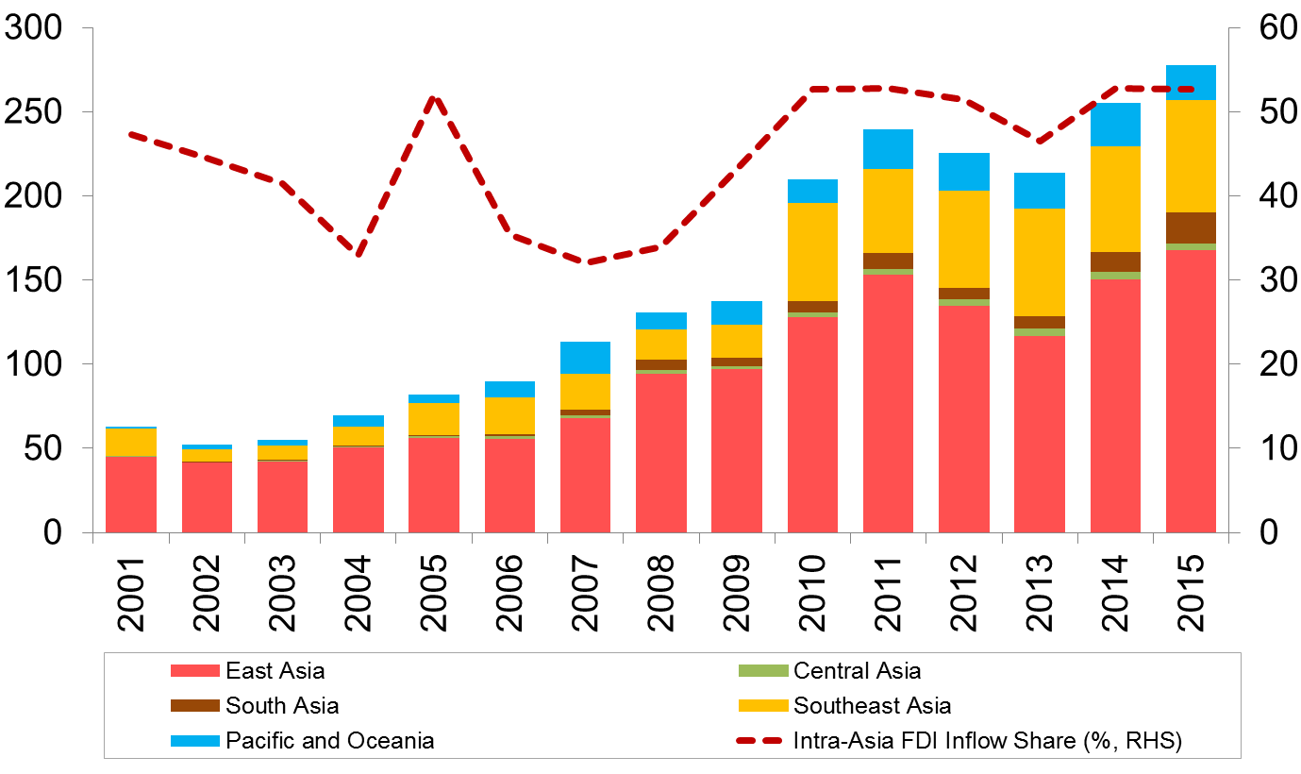
Intra-Asia FDI Inflows ($ billion)
Notes:
Intra-Asia FDI inflows ($ billion) generally increasing except for the slowdown after the GFC, but picked up again since 2014.
2001 = $62.7 billion
2011 = $239.5 billion
2013 = $213.5 billion
2014 = $255.3 billion
2015 = 277.3 billion
Intra-Asia FDI inflow share has been increasing since 2007
2001 = 47.3%
2007 = 32.1%
2010 = 52.7%
2013 = 46.5%
2014 = 52.8%
2015 = 52.6%
Bulk of Intra-Asia FDI inflows is coming from East Asia, followed by South East Asia
East Asia: $167.6 bn in 2015 (60.4% of intra-Asia FDI, up from $44.8bn in 2001
Southeast Asia: $66.5 bn in 2015 (24% of intra-Asia FDI), up from $16.2bn in 2001
Pacific and Oceania: $20.5bn from less than $1bn
South Asia: $18.8bn from $0.3bn
Central Asia: $4bn from $0.4bn

Slide 14
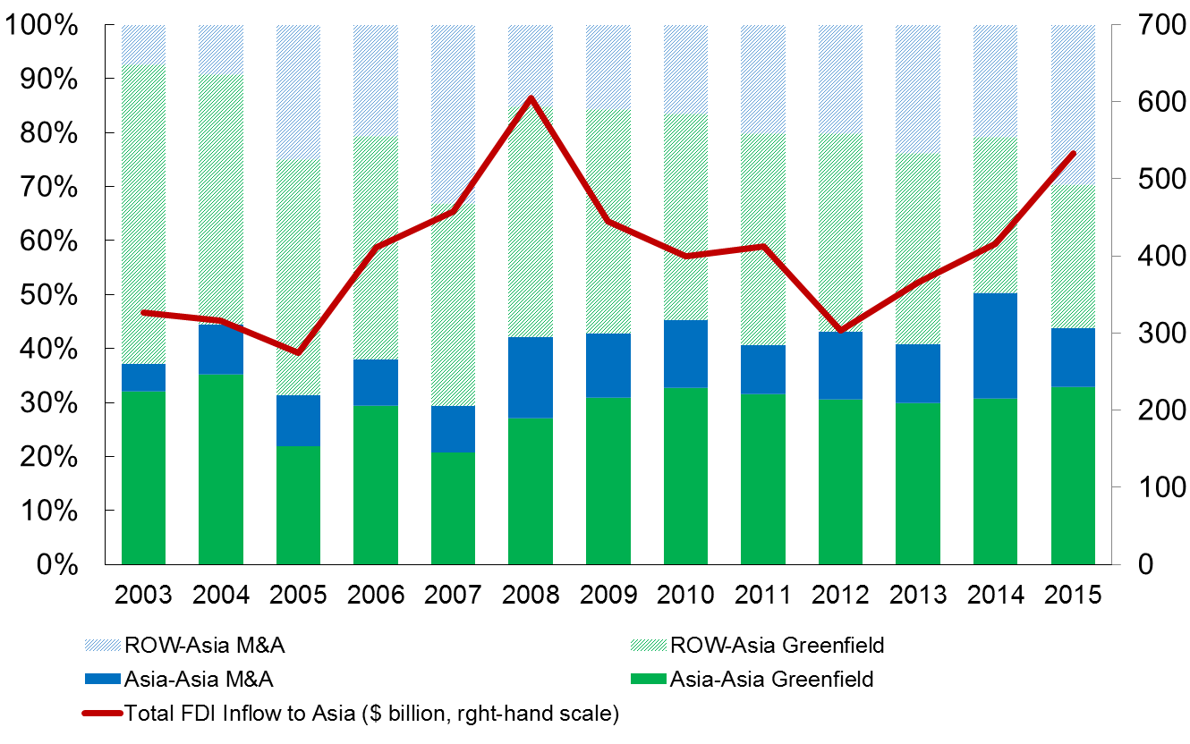
FDI flows into Asia (based on $ values)
Note. Based on aggregate project values of greenfield investment and M&As.
Source: ADB calculations using data from FDi Markets and Zephyr.
Notes:
Total FDI inflows going to Asia (sum of M&A and greenfield investment)
2003 = $326.5 bn
2005 = $274.8 bn
2008 = $604.8 bn
2012 = $302.8 bn
2014 = 416.3 bn
2015 = $532.7 bn
Out of this, around 45% came from Asia (sum of M&A and greenfield investment)
2003 = 37.3%
2005 = 31.6%
2008 = 42.3%
2012 = 43.3%
2014 = 50.4%
2015 = 44.1%

Slide 15
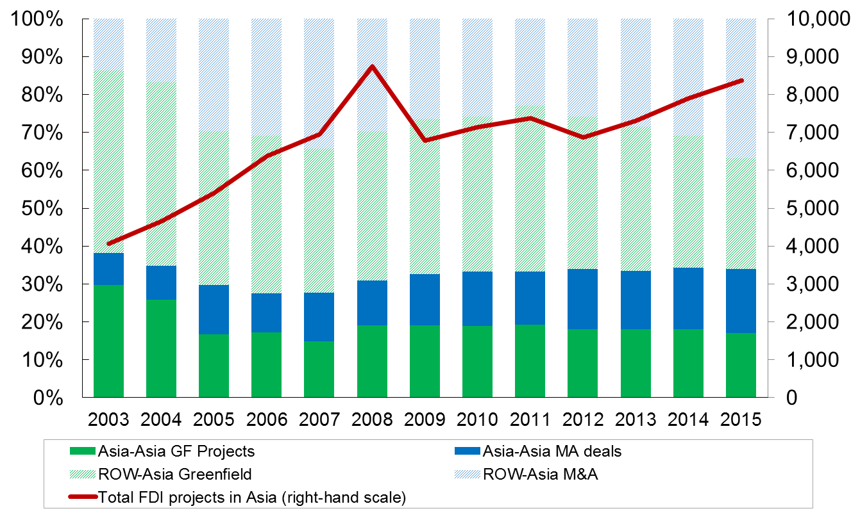
FDI flows into Asia (based on no. of projects)
Note. Based on aggregate number of projects/deals of greenfield investment and M&As.
Source: ADB calculations using data from FDi Markets and Zephyr.
Notes:
In terms of the number projects in both M&A and greenfield investment, FDI has steadily increased
2003 = 4,063
2005 = 5,396
2008 = 8,736
2012 = 6,872
2014 = 7,904
2015 = 8,370
Out of this, around 35% came from Asia (sum of M&A and greenfield investment)
2003 = 38.2%
2005 = 29.7%
2008 = 31.0%
2012 = 33.9%
2014 = 34.3%
2015 = 34.0%

Slide 16
Top sources of FDI in the world
Greenfield FDI
M&As
Rank | Income level | Source | No. of projects (2011-15)
1 | High | US | 14,949
2 | High | UK | 6,731
3 | High | Germany | 5,839
4 | High | Japan | 4,867
5 | High | France | 3,361
Rank | Income level | Source | No. of deals (2011-15)
1 | High | US | 17,887
2 | High | UK | 6,996
3 | High | Switzerland | 2,907
4 | High | Germany | 2,894
5 | High | France | 2,801

Slide 17
Top Asian sources of FDI to the world
Greenfield FDI
M&As
Rank | Income level | Source | No. of projects (2011-15)
1 | High | JPN | 4,867
2 | Low | PRC | 2,144
3 | Low | IND | 1,591
4 | High | AUS | 1,050
5 | High | KOR | 1,021
Rank | Income level | Source | No. of deals (2011-15)
1 | High | SIN | 2,558
2 | High | JPN | 2,188
3 | High | HKG | 1,672
4 | High | AUS | 1,338
5 | Low | PRC | 954

Slide 18
Top Asian hosts of FDI from the world
Greenfield FDI
M&As
Rank | Income level | Host | No. of projects (2011-15)
1 | Low | PRC | 5,161
2 | Low | IND | 3,513
3 | High | SIN | 1,906
4 | High | AUS | 1,638
5 | Low | VIE | 960
Rank | Income level | Host | No. of deals (2011-15)
1 | Low | PRC | 3,374
2 | Low | IND | 3,233
3 | High | AUS | 2,919
4 | High | JPN | 1,212
5 | High | SIN | 948

Slide 19
Orbis Data correction – Impact on Rankings
A: Top Sources using Acquirer Global Ultimate Owner country data
B: Top Sources using Acquirer country data
Ranking | Source country | Cross-border M&A (2004-2015) | 2011-2015
1 | United States | 39,685 | 18,690
2 | UK | 14,705 | 6,842
3 | Germany | 7,794 | 3,423
4 | Japan | 5,809 | 2,982
5 | France | 6,947 | 2,974
6 | Switzerland | 6,655 | 2,816
7 | Spain | 2,099 | 857
8 | Netherlands | 5,277 | 2,463
9 | Canada | 5,434 | 2,546
10 | PRC | 1,897 | 1,089
Ranking | Source country | Cross-border M&A (2004-2015) | 2011-2015
1 | United States | 37,383 | 17,887
2 | UK | 16,590 | 6,996
3 | Switzerland | 6,375 | 2,907
4 | Germany | 7,128 | 2,894
5 | France | 6,321 | 2,801
6 | Singapore | 4,265 | 2,558
7 | Canada | 5,231 | 2,365
8 | Japan | 4,229 | 2,188
9 | Netherlands | 5,010 | 2,169
10 | Virgin Islands (British) | 3,961 | 2,084
Note: Economies are ranked according total M&A deals 2004-2015.
Source: ADB calculations using Zephyr M&A database and Orbis company database.
Notes:
Apart from target and acquiror names and country, information on global ultimate owner (GUO) name and country, are also available in Zephy M&A database by Bureau van Dijk (BVD). GUO refers to the shareholder with the highest direct or total % of ownership of the subject company, which is not located in the same country. There are instances, wherein information on GUO of the acquiror is not in Zephyr database. For these cases, we search for the GUO information of the acquiror in Orbis, a company database also owned by BVD. If still unavailable, we assume the acquiror and its country, to be the acquiror GUO.

Slide 20
Orbis Data Correction – Impact on Rankings
A: Top Sources using Acquiror Global Ultimate Owner country data
B: Top Sources using Acquiror country data
Ranking | Source Country | Cross-border M&A (2004-2015) | Cross-border M&A (2011-2015)
1 | United States | 2,212.62 | 1,004.99
2 | UK | 1,403.70 | 508.81
3 | France | 726.42 | 280.22
4 | Germany | 584.67 | 205.73
5 | Japan | 559.13 | 275.48
6 | Switzerland | 552.19 | 281.16
7 | Canada | 515.95 | 274.90
8 | Netherlands | 512.96 | 230.49
9 | Ireland | 343.43 | 244.22
10 | PRC | 335.88 | 172.79
*US $ billion
Ranking | Source Country | Cross-border M&A (2004-2015) | Cross-border M&A (2011-2015)
1 | United States | 2,005.73 | 884.67
2 | UK | 1,146.58 | 431.35
3 | Netherlands | 633.43 | 272.86
4 | France | 571.62 | 191.36
5 | Canada | 472.56 | 226.22
6 | Germany | 456.65 | 141.51
7 | Switzerland | 350.73 | 161.26
8 | Japan | 337.60 | 182.51
9 | Ireland | 306.40 | 247.83
10 | Spain | 302.81 | 79.38
Note: Economies are ranked according total M&A deal value 2004-2015.
Source: ADB calculations using Zephyr M&A database and Orbis company database.

Slide 21
Figure. Number of M&A Deals - comparing the 2 datasets
(count, thousands)
Source: ADB calculations using Zephyr M&A database and Orbis company database.

Slide 22
Top industry recipients of FDI in the world
Greenfield FDI
M&As
 | Sector | Industry | No. of projects (2011-15)
1 | Services | Software & IT services | 9,930
2 | Services | Business Services | 8,303
3 | Services | Financial Services | 6,423
4 | Others | Industrial Machinery, Equip. & Tools | 4,624
5 | Services | Communications | 3,725
Services (% of total) |  |  | 43.6
Primary (% of total) |  |  | 5.0
Others (% of total |  |  | 51.4
All industries (no. of projects) |  |  | 67,627
 | Sector | Industry | No. of projects (2011-15)
1 | Services | Communications | 10,519
2 | Services | Business Services | 7,628
3 | Services | Software & IT services | 7,297
4 | Services | Financial Services | 6,088
5 | Others | Consumer Products | 4,098
Services (% of total) |  |  | 48.1
Primary (% of total) |  |  | 9.7
Others (% of total |  |  | 42.1
All industries (no. of projects) |  |  | 70,023
Notes:
Sector classification is from FDI Markets, based on NAICS 2012 codes. Services include Business Services, Communications, Software & IT services, Financial Services Paper, Printing and Packaging, Warehousing & Storage, and Personal, Public and Social Services. Primary sector include Coal, Oil and Natural Gas, Metals and Minerals. Others include Industrial Machinery, Equipment & Tools Transportation Automotive Components Chemicals Food & Tobacco Electronic Components Real Estate Plastics Consumer Products Alternative/Renewable energy Automotive OEM Pharmaceuticals Textiles Medical Devices Aerospace Business Machines & Equipment Consumer Electronics Building & Construction Materials Rubber Beverages Non-Automotive Transport OEM Semiconductors Healthcare Biotechnology Engines & Turbines Ceramics & Glass Wood Products Space & Defense.

Slide 23
GVC-FDI: Most common country pairs
Destination | Origin | No. of Affiliates that Import and Export | % of Affiliates that Import and Export
1. PRC | Japan | 2,260 | 81%
2. PRC | Hong Kong, China | 1,314 | 76%
3. PRC | United States | 646 | 74%
4. PRC | Germany | 625 | 76%
5. PRC | Taipei,China | 401 | 79%
6. PRC | Korea | 358 | 86%
7. PRC | Singapore | 337 | 71%
8. Viet Nam | Japan | 306 | 72%
9. Thailand | Japan | 258 | 64%
10. Indonesia | Japan | 214 | 53%
11. Taipei,China | Japan | 212 | 74%
12. PRC | France | 177 | 77%
13. Malaysia | Japan | 175 | 78%
14. Philippines | Japan | 171 | 69%
15. Singapore | Japan | 164 | 54%
Notes:
GVC-FDI: foreign affiliates engaged in both exports and imports
Four-digit SIC code of the primary industry of the firm
27 Asian host countries, 35 source countries, including 10 Asian countries (Australia, Hong Kong, China, India, Indonesia, Japan, Korea, Malaysia, Singapore, Thailand, Taipei,China.

Slide 24
GVC-FDI into Asia: Host economies, by sector

Slide 25
GVC-FDI from Asia: Source economies, by sector
% of economy total

Slide 26
Top destination of PRC’s and India’s GVC-FDI
Source: PRC | % share
1. Viet Nam | 29
2. Hong Kong, China | 24
3. Singapore | 16
4. Philippines | 7
5. Australia | 7
Source: India | % share
1. Singapore | 41
2. PRC | 14
3. Australia | 10
4. Indonesia | 9
5. Japan | 5
Thailand | 5
Viet Nam | 5
Notes:
Notes: Number of affiliates that export and import, in each country, as a share of the total number of affiliates that export and import belonging to GUHs from each of the selected countries.

Slide 27
Rising number of BITs
World BITs
BITs within Asia
Source: UNCTAD.

Slide 28
BITs involving Asian economies
Regional Pair | UNCTAD Database |  | BIT Selection Index (BITSel) Database
 | Number | % of total | Number | % of total
Asia-Asia | 306 | 28.5 | 142 | 29.3
Asia-PRC | 27 | 2.5 | 8 | 1.6
Asia-Japan | 13 | 1.2 | 8 | 1.6
Asia-KOR | 21 | 2.0 | 11 | 2.3
Asia-US | 8 | 0.7 | 7 | 1.4
Asia-EU | 367 | 34.1 | 177 | 36.5
Asia-ROW | 333 | 31.0 | 132 | 27.2
Total | 1,075 | 100.0 | 485 | 100.0
Source: ADB calculations using data from UNCTAD and BITSel Database from Chaisse and Bellak (2015).
Notes:
Notes:
(i) No. of UNCTAD BITs refers to the accumulated number of BITs in the period 2000-2016 according to the UNCTAD database, while No. of BITSel BITs refers to the accumulated number of BITs according to the BITSel database by Chaisse and Bellak (2015).
(ii) Asia refers to the 48 regional members of the Asian Development Bank.
(iii) EU refers to the 28 member countries of the European Union.
(iv) ROW denotes the all the countries excluding Asia, PRC, Japan, Korea, US, and EU.

Slide 29
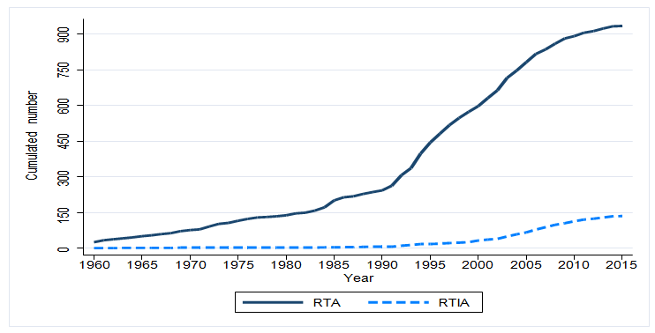
Rising number of RTIAs
Source: DESTA

Slide 30
Five broad categories of BIT/ RTIA provisions
$$entry$$
𝒆𝒏𝒕𝒓𝒚
average of entry rules (admission vs establishment)
non-economic standards (yes vs no)
$$treat$$
𝒕𝒓𝒆𝒂𝒕
average of national treatment (no vs yes)
most favored nation (no vs yes)
$$scope$$
𝒔𝒄𝒐𝒑𝒆
average of definition of investment (narrow vs broad)
umbrella clause (no vs yes)
free transfer of investment related funds (no vs yes)
temporal scope of application (short vs long)
$$protec$$
𝒑𝒓𝒐𝒕𝒆𝒄
average of fair and equitable treatment (no vs yes)
direct and indirect expropriation covered (no vs yes)
$$isdm$$
𝒊𝒔𝒅𝒎
investor-related dispute mechanism (no vs yes)

Slide 31
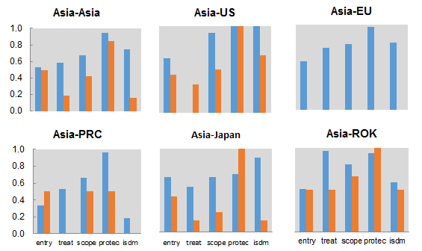
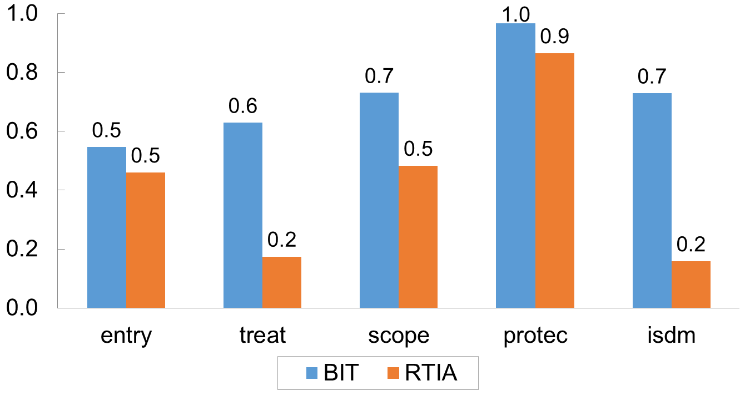
BITs grant foreign investors more substantive rights than RTIAs
Average scores of provisions in BITs and RTIAs
Asia-World
Notes:
Source: ADB calculations using data from Chaisse and Bellak (2015).

Slide 32
BIT Provisions over Time: Asian Region

Slide 33
Determinants of FDI

Slide 34
Effect of ease of doing business & governance on FDI
 | Greenfield investment |  |  |  | Cross-border M&A
Source | High-income |  | Emerging |  | High-income |  | Emerging
Host | High-income | Developing | High-income | Developing | High-income | Developing | High-income | Developing
Overall Ease of Doing Business Index - host | 0.005 | 0.022*** | -0.002 | -0.001 | 0.004 | 0.009 | -0.007 | -0.014
Overall World Governance Index - host | 0.026*** | 0.043*** | 0.031* | 0.021*** | 0.042*** | 0.072*** | 0.044*** | 0.051***
Notes:
Governance matters more for N-S in both greenfield and M&A
If the Philippines’ overall governance were not the level of 40.6 but were the level of Malaysia(56.8), greenfield from high-income countries would have been 80% higher from 2004 to 2015.
Similarly, if the Philippines’ overall EoDB were not the level of 50.5 but were close to the level of Malaysia(73.8), greenfield would have been 52% larger.
S

Slide 35
Interaction effects of EoDB and WGI on greenfield FDI flows from high-income to developing
 | Dependent variable: Greenfield FDI
EoDB | 0.096***
EoDB*WGI_ave | -0.002***
WGI_ave | 0.140***
Notes:
For example, at 34.7 of WGI_ave (bottom quartile), the marginal effect of EoDB is 0.40 and statistically significant, while at 47.4 of WGI_ave (top quartile), the marginal effect of EoDB is -0.0048 and statistically insignificant.

Slide 36
Effects of "Sub-indicators of Governance" on FDI
 | Source | Host | WGI_ave | Voice and Accountability | Political stability | Government effectiveness | Regulatory quality | Rule of law | Control corruption
Greenfield | High-income | High-income | 0.032*** | 0.002 | 0.013*** | 0.031*** | 0.042*** | 0.032*** | 0.026***
 |  | Developing | 0.048*** | 0.017*** | 0.025*** | 0.039*** | 0.046*** | 0.030*** | 0.027***
 | Emerging | High-income | 0.028** | -0.007 | 0.014* | 0.029*** | 0.039*** | 0.032** | 0.032***
 |  | Developing | 0.020*** | 0.011*** | 0.015*** | 0.005 | 0.020*** | 0.004 | 0.008*
Cross-border M&A | High-income | High-income | 0.044*** | 0.036*** | -0.002 | 0.034*** | 0.054*** | 0.040*** | 0.030***
 |  | Developing | 0.071*** | 0.033*** | 0.036*** | 0.049*** | 0.065*** | 0.043*** | 0.040***
 | Emerging | High-income | 0.040*** | 0.020*** | -0.007 | 0.036*** | 0.056*** | 0.042*** | 0.026***
 |  | Developing | 0.042*** | 0.029*** | 0.019*** | 0.021** | 0.045*** | 0.017** | 0.017**

Slide 37
Effects of "WGI" on FDI in different Sectors
 |  | Greenfield investment |  |  | Cross-border M&A
Source | Host | Primary sector | Service sector | Other | Primary sector | Service sector | Other
High-income | High-income | 0.038*** | 0.023*** | 0.039*** | 0.089*** | 0.039*** | 0.038***
 | Developing | 0.032*** | 0.051*** | 0.048*** | 0.034*** | 0.077*** | 0.075***
Emerging | High-income | 0.022* | 0.014 | 0.045*** | 0.167*** | 0.023** | 0.032***
 | Developing | 0.011 | 0.022*** | 0.020*** | 0.022* | 0.045*** | 0.047***

Slide 38
Effects of RTA and BIT on FDI
 | Greenfield investment |  |  |  | Cross-border M&A
Source | High-income |  | Emerging |  | High-income |  | Emerging
RTA between source and host (= 1 if yes) | 0.099** |  | -0.279*** |  | -0.066 |  | 0.154
BIT between source and host (= 1 if yes) | 0.050 |  | 0.214** |  | -0.136 |  | 0.068
RTA * high-income host |  | -0.015 |  | 0.155 |  | -0.159 |  | -0.250
RTA * Developing host |  | 0.157** |  | -0.412*** |  | 0.055 |  | 0.510**
BIT * high-income host |  | 0.033 |  | 0.157 |  | -0.190 |  | 0.265
BIT * Developing host |  | 0.050 |  | 0.227** |  | -0.118 |  | -0.182
Notes:
Notes: 1. Estimates are obtained with Poisson Psuedo-Maximum Likelihood (PPML) estimator. Spec 2 includes source country-period fixed effects and host country-period fixed effects as well as period fixed effects. 3. Standard errors are in parenthesis are based on clustering by country-pair. 4. ***, **, and * indicate the significance levels of 1, 5, and 10 percent, respectively.

Slide 39
Determinants of GVC Trade: Country Characteristics
 | Dependent variable: DVA as % of gross exports
 | (1) | (2) | (3) | (4) | (5) | (6)
export upstreamness | 0.052*** | 0.081*** | 0.099*** | 0.164*** | 0.242*** | 0.216***
Obs | 183,068 | 79,597 | 5,362 | 42,195 | 20,539 | 1,249
R-sq | 0.670 | 0.577 | 0.420 | 0.690 | 0.675 | 0.647
sample industries | all | mfg | mining | all | mfg | mining
sample countries | all | all | all | Asia | Asia | Asia
Notes:
Notes: Observations are at the bilateral country-sector level, for different years. Controls refer to the exporter coun- try. All specifications with importer and industry-year fixed effects. Robust standard errors, clustered by importer- exporter, in parentheses. Levels of significance are denoted by ** p<0.01, * p<0.05, + p<0.1.

Slide 40
GVC-FDI and Average Country Characteristics
Affiliates with: | Average Country Characteristics
 | imports & exports | only domestic sale
Integration variables
Trade restrictiveness index | 0.05 | 0.05
burden of custom proc. | 4.43 | 4.77
cost to export ($ per container) | 577 | 752
cost to import ($ per container) | 622 | 804
# documents to export | 6.74 | 5.24
# documents to import | 5.35 | 5.83
logistics performance index | 3.48 | 3.57
quality of port infrastructure | 4.55 | 4.93
applied tariff rate | 3.53 | 2.48
RTAs | 0.34 | 0.36
BITs | 0.55 | 0.38
BITs, investor-state-of-dispute | 1.9 | 1.7
DTTs | 0.91 | 0.78
Comparative advantage variables
real GDP p.c. (rgdpl) | 13,006 | 24,227
K-L ratio | 76,379 | 156,101
avg year schooling | 7.61 | 8.73
log rgdpl, host rel. to source | -1.32 | -0.75
log K-L ratio, host rel. to source | -1.51 | -0.78
Affiliates with: | Average Country Characteristics
 | imports & exports | only domestic sale
Institutional variables
rule of law | -0.09 | 0.68
regulatory quality | 0.05 | 0.76
government effectiveness | 0.27 | 0.87
control of corruption | -0.05 | 0.69
political stability | -0.29 | 0.23
voice & accountability | -0.95 | 0.12
Policy Variables
days req to enforce a contract | 390 | 353
# proc. to register a biz start-up | 6.6 | 4.45
cost of biz start-up proc. (% of GNI) | 8.6 | 4.7
days to get electricity | 57.9 | 58.9
days req to register property | 27.1 | 16.4
days req to start biz | 17.1 | 8.2
time spent dealing w/Gov. reg. | 0.9 | 0.9
hours req to prepare and pay taxes | 304 | 168
priv.credit (% of GDP) | 0.46 | 0.91
GVC-trade variables
dva share | 0.72 | 0.79
fva share | 0.21 | 0.16
export upstreamness (overall) | 1.97 | 2.2

Slide 41
Determinants of GVC–FDI: Country Characteristics
 | Dependent variable: D(exports>0 & imports >0)
 | (1) | (2) | (3) | (4) | (5)
log aff sales | 0.038*** | 0.036*** | 0.037*** | 0.044*** | 0.038***
log rgdp | -0.030*** | -0.092*** | 0.013*** | -0.059*** | 0.032***
log rgdpl | 0.714*** | 0.095 | 0.671*** | 0.940*** | 0.150**
log KL | -0.495*** | -0.173* | -0.777*** | -1.056*** | -0.525***
log yr.sch. | -0.010* | -0.029*** | 0.021*** | 0.053*** | 0.118***
rule of law | -0.296***
private credit |  | 0.227***
TRI |  |  | -3.446***
exp. upstreamness |  |  |  | -0.548***
× kl |  |  |  | 0.009*
exporter dva share |  |  |  |  | -1.034***
D(Asian GUH) | 0.118 | -0.009 | 0.032 | -0.190** | 0.124
× rule of law | 0.012
× log rgdpl | -0.012
× priv. credit |  | 0.003
× TRI |  |  | -0.097
× exp.upstr. |  |  |  | 0.108***
× exp. dva share |  |  |  |  | -0.151
Obs | 17,126 | 8,581 | 15,458 | 12,256 | 14,344
R-sq | 0.351 | 0.283 | 0.355 | 0.200 | 0.375
sample | foreign | foreign | foreign | foreign | foreign
Notes:
Notes: The dependent variable is a dummy variable equal to one if the plant reports export and import activity. Country- level variables are for the country the plant is located. The variable "private credit" refers to private credit as share of GDP. The variable "TRI" refers to the trade restrictiveness index from the World Bank. The variable "exp. upstreamness" refers to the level of export upstreamness of the host country. DVA is calculated as a share of gross exports of the destination country, at the country level, an average across years, for all sectors. The dummy D(Asian GUH) equals one if the plant belongs to a GUH in Asia. kl indicates the (log) capital intensity, with respect to labor, of the industry of the affiliate. In columns 1-5, domestic plants which are also GUHs are excluded. All specifications with affiliate industry fixed effects. Standard errors, clustered at the parent level, in parentheses. Levels of significance are denoted by ** p<0.01, * p<0.05, + p<0.1.

Slide 42
Determinants of GVC–FDI: Industry Characteristics
 | Dependent variable: D(exports>0 & imports >0)
 | (1) | (2) | (3)
log affiliate sales | 0.049*** | 0.050*** | 0.050***
log kl | -0.177** | -0.056** | -0.047**
× exp.upstr. | 0.060*
log sl | -0.009 | -0.008 | -0.020
R & D | 0.351 | 0.335 | 0.483
D(dr_{ap} > 0 & dr_{pa} > 0) | 0.026+
avg dr_{ap} |  | 0.343
avg dr_{pa} |  |  | 0.807
D(Asian GUH) | -0.484*** | -0.472*** | -0.444***
× log kl | 0.055** | 0.053** | 0.047**
× avg dr_{ap} |  | -0.224
× avg dr_{pa} |  |  | -0.047
Obs | 6,393 | 6,393 | 6,393
R-sq | 0.220 | 0.219 | 0.220
sample | foreign | foreign | foreign
Notes:
Notes: The dependent variable is a dummy variable equal to one if the establishment reports export and import activity. The variable "kl" refers to the (log) capital intensity of the industry, relative to labor, while sl refers to the (log) skill intensity of the industry, relative to (unskilled) labor. The dummy D(drap > 0 & drpa > 0) is equal to one when both direct requirement coefficients (i.e. when the affiliate is upstream and downstream of the parent) are higher than zero. Avg drap (drpa) refers to the average direct requirement coefficient of the industry of the affiliate, with respect to downstream (upstream) industries. The dummy D(Asian GUH) is one if the plant has an Asian GUH. Only plants that are not GUH and in the manufacturing sector. All specifications with source and destination fixed effects. Standard errors, clustered at the parent level, in parentheses. Levels of significance are denoted by ** p<0.01, * p<0.05, + p<0.1.

Slide 43
Production Fragmentation and GVC-FDI
 | Dependent Variable
 | Log affiliate sales |  | Number of affiliates that import and export | log(Share of foreign affiliates) | Log(Share of trade-oriented foreign affiliates)
dr_{ap} | 0.221**
dr_{pa} |  | 0.286***
Number of affiliates with dr_{ap}>0 & dr_{pa}>0 |  |  | 0.547***
Log (share of domestic affliliates with dr_{ap}>0 & dr_{pa}>0 |  |  |  | 0.279*** | 0.065*
Observations | 6787 | 6787 | 8741 | 451 | 407
R-sq | 0.039 | 0.056 | 0.634 | 0.866 | 0.588
Sample | Foreign | Foreign | Foreign

Slide 44
BIT Analysis: Econometric Model
BITs: FDIij = exp(δ1BITij + CONTij β + θFDI03ij + αi + αj )ϵij
Where:
FDIij = the cumulated number of FDI projects of firms headquartered in source country i in destination country j,
BITij = existence, for at least two years, of an enforced BIT or of various BIT-related investment provisions,
CONTij = vector of dyadic control variables,
FDI03ij = the (log +1) value of the number of bilateral projects in 2003,
αi are country fixed effects, and
ϵij is a multiplicative error term.
RTIAs: FDIij = exp(δ1BIT ij + δ2RTIAij + CONT ij β + θFDI03ij + αi + αj )ϵij
where RTIAij indicates the existence, for at least two years, of a RTIA or of various RTIA-related investment provisions

Slide 45
Effect of BITs on aggregate FDI
By specific BIT provision
 | BIT | Entry | Treat | Scope | Protec | ISDM
BIT provision | 0.264*** (0.064) | 0.402*** (0.106) | 0.196*** (0.071) | 0.276*** (0.072) | 0.275*** (0.063) | 0.302*** (0.063)
Obs | 26,093 | 26,093 | 26,093 | 26,093 | 26,093 | 26,093
Dependent variable = cumulated number of FDI projects (greenfield plus M&As) of firms headquartered in source economy I in destination economy j at time t
*** p-value<0.01 ** p-value<0.05 * p-value<0.10. Cluster-robust standard errors in parentheses. Country fixed effects, the dyadic control variables, DTT ,and RTA are included in all columns.
Notes:
2004-2010
Distance, time zone difference, common border/language/regligion/legal origin/colonials are controlled. Also, existence of RTA or currency union is controlled, country fixed effects are also controlled.

Slide 46
ISDM is the most important BIT provision
Effect of BIT provisions on cumulated number of FDI projects
 | (1) | (2) | (3) | (4) | (5) | (6)
ISDM | 0.282* | 0.287** | 0.297** | 0.308*** | 0.327** | 0.265*
BIT |  | 0.016
Entry | -0.019 |  | 0.009
Treat | -0.024 |  |  | -0.012
Scope | -0.129 |  |  |  | -0.035
Protec | 0.159 |  |  |  |  | 0.042
Obs | 26,093 | 26,093 | 26,093 | 26,093 | 26,093 | 26,093
*** p-value<0.01 ** p-value<0.05 * p-value<0.10. Cluster-robust standard errors in parentheses. Country
fixed effects, the dyadic control variables,, DTT, and RTA are included in all columns.

Slide 47
TREAT is the most important RTIA provision
 | (1) | (2) | (3) | (4) | (5) | (6)
Treat | 0.679** | 0.460*** | 0.390* | 0.436*** | 0.349 | 0.722**
RTIA |  | 0.007
Entry | 0.033 |  | 0.119
Scope | 0.256 |  |  | 0.287*
Protec | 0.128 |  |  |  | 0.119
ISDM | -0.432 |  |  |  |  | -0.294
BIT | 0.240*** | 0.247*** | 0.253*** | 0.244*** | 0.234*** | 0.252***
Obs | 22,585 | 22,585 | 22,585 | 22,585 | 22,585 | 22,585
*** p-value<0.01 ** p-value<0.05 * p-value<0.10. Cluster-robust standard errors in parentheses. Country
fixed effects, the dyadic control variables described in section 2, and DTT are included in all columns.
Notes:
BIT = Bilateral investment treaties, RTA = regional trade agreements, DTT = double taxation treaties

Slide 48
Effects of RTIA provisions by destination sector
 | RTIA | Entry | Treat | Scope | Protec | ISDM
RTIA provision | -0.044 | 0.356** | 0.361** | 0.198 | 0.232** | 0.161
Provision X Services | 0.088 | 0.085 | 0.263* | 0.255 | -0.009 | -0.097
Provision X Nat resource | 0.438 | -0.255 | -0.760* | 0.438 | 0.078 | -0.042
BIT | 0.177** | 0.217*** | 0.212*** | 0.179** | 0.182*** | 0.190***
Obs | 67,755 | 67,755 | 67,755 | 67,755 | 67,755 | 67,755
*** p-value<0.01 ** p-value<0.05 * p-value<0.10. Cluster-robust standard errors in parentheses. Country
fixed effects, the dyadic control variables and DTT are included in all columns. ‘NS’ (North-South) and ‘SS’ (South-South) are dummy variables.

Slide 49
Key Messages
Determinants of FDI are diverse across different mode of entry, motivation, sectors, and source economies
Greenfield FDI is the most common in manufacturing while M&A in services
Governance is the most important factor for both greenfield FDI and M&A, more so for M&A
Improving business environment could supplement low governance in developing countries
Export downstreamness, labor abundance, low trade barriers and access to credit foster GVC FDI in the context of Asia
Greater domestic production fragmentation attracts more GVC FDI
Heterogeneity of BIT has increased over time but BIT in general has positive impact on FDI
ISDM in BIT is the most important factor in inducing FDI
NT and MFN in RTIA is the most important factor in inducing FDI

Slide 50
Thank You!

Slide 51
Spare slides

Slide 52
Effects of "Sub-indicators of EoDB" on FDI
FDI from high-income economies to developing economies
 | Greenfield | M&A
EoDB_ave | 0.022*** | 0.009
Starting business | 0.007* | 0.006*
Dealing with business construction | 0.005 | -0.014***
Registering property | 0.012*** | 0.009**
Getting credit | 0.008*** | 0.015***
Protecting minority investors | 0.001 | 0.010**
Paying taxes | -0.002 | 0.003
Trading across borders | 0.011*** | -0.005
Enforcing contracts | 0.009** | 0.004
Resolving insolvency | 0.000 | -0.002

Slide 53
GVC FDI: Most common industries
Affiliate industry | Number of affiliates that import & export
1. Motor Vehicle Brake System | 1,925
2. Other Electronic Component | 1,358
3. Plastics Pipe and Pipe Fitting | 980
4. Pharmaceutical Preparation | 859
5. Paint and Coating | 710
6. Semiconductor and Related Device | 694
7. Custom Computer Programming Services | 542
8. Telemarketing Bureaus | 532
9. Farm Machinery and Equipment | 490
10. Ethyl Alcohol | 477
11. Plastics Material and Resin | 465
12. All Other Petroleum and Coal Products | 434
13. All Other Miscellaneous General Purpose Machinery | 433
14. Other Engine Equipment | 395
15. Computer Systems Design Services | 391

Slide 54
Top Asian sources of FDI into Asia
Greenfield FDI
M&As
Rank | Income level | Source | No. of projects (2011-15)
1 | High | JPN | 2,499
2 | Low | PRC | 667
3 | High | SIN | 549
4 | Low | TAP | 547
5 | High | KOR | 465
High-income (% of total) |  |  | 65.7
Emerging (% of total) |  |  | 34.3
All (number of projects) |  |  | 6,849
Rank | Income level | Source | No. of deals (2011-15)
1 | High | SIN | 1,834
2 | High | JPN | 1,084
3 | High | HKG | 1,015
4 | High | AUS | 445
5 | Low | MAL | 321
High-income (% of total) |  |  | 79.4
Emerging (% of total) |  |  | 20.6
All (number of deals) |  |  | 5,939

Slide 55
GVC-FDI and Average Country Characteristics
Affiliates with: | Average Country Characteristics
 | imports & exports | only domestic sale
Integration variables
Trade restrictiveness index | 0.05 | 0.05
burden of custom proc. | 4.43 | 4.77
cost to export ($ per container) | 577 | 752
cost to import ($ per container) | 622 | 804
# documents to export | 6.74 | 5.24
# documents to import | 5.35 | 5.83
logistics performance index | 3.48 | 3.57
quality of port infrastructure | 4.55 | 4.93
applied tariff rate | 3.53 | 2.48
RTAs | 0.34 | 0.36
BITs | 0.55 | 0.38
BITs, investor-state-of-dispute | 1.9 | 1.7
DTTs | 0.91 | 0.78
Comparative advantage variables
real GDP p.c. (rgdpl) | 13,006 | 24,227
K-L ratio | 76,379 | 156,101
avg year schooling | 7.61 | 8.73
log rgdpl, host rel. to source | -1.32 | -0.75
log K-L ratio, host rel. to source | -1.51 | -0.78
Affiliates with: | Average Country Characteristics
 | imports & exports | only domestic sale
Institutional variables
rule of law | -0.09 | 0.68
regulatory quality | 0.05 | 0.76
government effectiveness | 0.27 | 0.87
control of corruption | -0.05 | 0.69
political stability | -0.29 | 0.23
voice & accountability | -0.95 | 0.12
Policy Variables
days req to enforce a contract | 390 | 353
# proc. to register a biz start-up | 6.6 | 4.45
cost of biz start-up proc. (% of GNI) | 8.6 | 4.7
days to get electricity | 57.9 | 58.9
days req to register property | 27.1 | 16.4
days req to start biz | 17.1 | 8.2
time spent dealing w/Gov. reg. | 0.9 | 0.9
hours req to prepare and pay taxes | 304 | 168
priv.credit (% of GDP) | 0.46 | 0.91
GVC-trade variables
dva share | 0.72 | 0.79
fva share | 0.21 | 0.16
export upstreamness (overall) | 1.97 | 2.2

Slide 56
Determinants of FDI entry modes and GVC-FDI (OLS)
 | Dependent variable (log) : Ratio of M&A and Greenfield projects, bilateral country-sector level
 | (1) | (2) | (3) | (4) | (5) | (6)
log gvc fdi | -0.263* | -0.214+ | -0.395* | -0.346+ | -0.950** | -0.791*
log dist | -0.313** | -0.377** | -0.250* | -0.325** | 0.093 | -0.41
D(sharing language) | 0.446* | 0.452** | 0.750** | 0.710** | -0.795 | -0.973
D(sharing colonial past) | -0.148 | -0.201 | -0.031 | -0.158 | -0.178 | 0.434
D(RTA) | 0.242 | 0.398* | 0.259 | 0.423* | 0.852+ | 1.378+
D(DTT) | -0.101 | -0.072 | 0.219 | 0.21 | -0.225 | 0.42
D(BIT) | -0.486** | -0.263* | -0.664** | -0.421** | 0.245 | 0.924
log rgdpld/rgdplo | -0.656** | -1.034** | -0.805** | -1.336** | -0.584 | -1.577
log KLd/KLo | 0.299 | 0.258 | 0.573* | 0.563+ | -0.35 | 1.117
log yrschd/yrscho | 1.396** | 1.425** | 1.192** | 1.460** | 3.238** | 0.19
log rgdpl |  | 0.594 |  | 0.772 |  | 11.438+
log KL |  | 0.046 |  | -0.024 |  | -14.836+
log rgdp |  | 0.122* |  | 0.062 |  | -1.043
yr.sch. |  | 0.003 |  | -0.034 |  | 1.788+
Observations | 363 | 363 | 237 | 237 | 27 | 27
R-squared | 0.367 | 0.423 | 0.345 | 0.413 | 0.735 | 0.79
sample | all | all | mfg | mfg | mining | mining
Notes:
Notes: The dependent variable is the ratio of the number of M&A to the number of greenfield FDI, in logs, at the bilateral-country sector level. Specifications in columns 1 and 2 with sector fixed effects. Standard errors, clustered at the host-source country level, in parentheses. Levels of significance are denoted by ** p<0.01, * p<0.05, + p<0.1.

