Slide 1
Development Connections Unveiling the Impact of New Information Technologies Development in the Americas, 2011

Slide 2
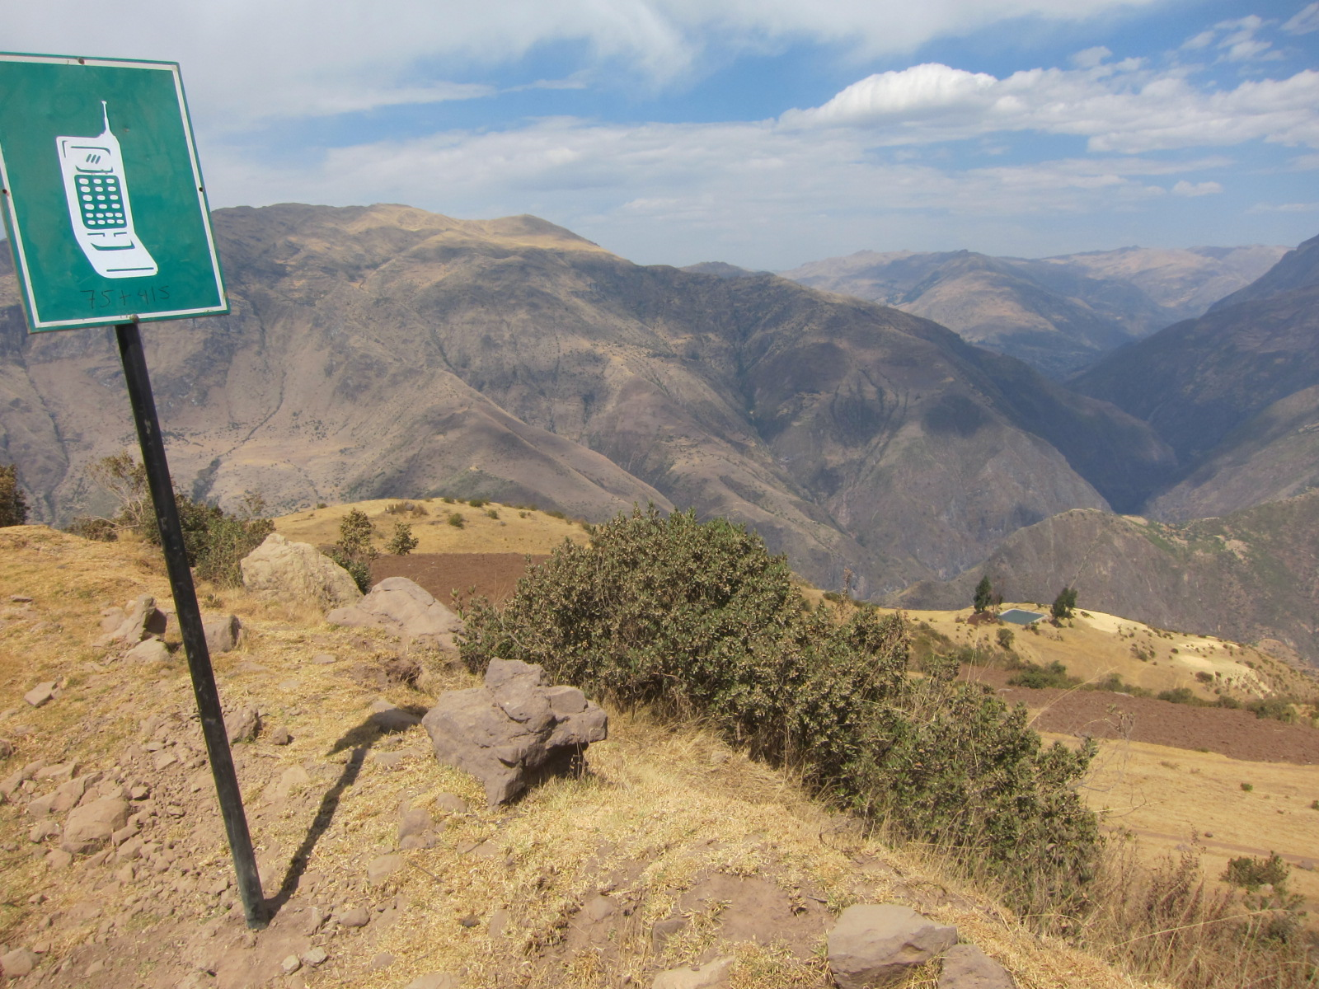
ICTs on top of the world?
Courtesy: Richard Webb

Slide 3
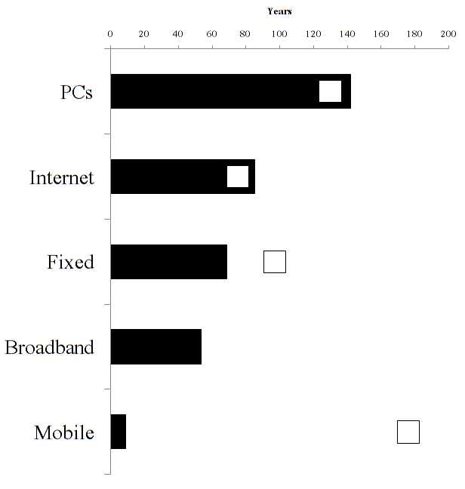
How far behind is LAC?
Source: DIA (2011).

Slide 4
What is the return?

Slide 5
What do we do?
Very little is known, no data, we’re closing gap.
First systematic study on impact
Nearly fifty projects studied all over Latin America (“randomized controlled trials”)
Many research teams involved

Slide 6
Projects Undertaken

Slide 7
Do ICTs work?

Slide 8
Not a Silver Bullet

Slide 9
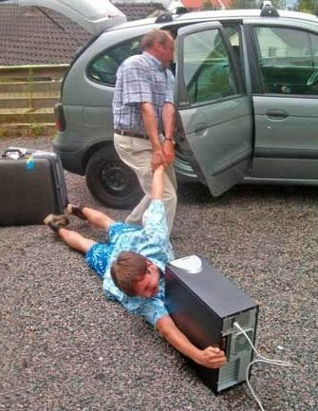
Human capital, Infrastructure, Regulations…
Technologies do not magnify the positive, only.

Slide 10
Successful Examples

Slide 11
Savings Reminders –Bolivia
Clients who received monthly reminders saved 6% more than individuals who did not
Reminders that mentioned a specific future expenditure of the individual increased his/her savings by 16%

Slide 12
Internet-based Sex Education in Colombia
Significant improvements in sexual knowledge and attitudes (STD prevention, condom use, pregnancy prevention and sexual violence/abuse)
Kids are more able to identify safe and risky sexual practices, STD symptoms and violent/abusive sexual situations
More importantly, behavioral change: teenagers initiate sexual activity later and have fewer sexual partners
Reduction in pregnancies, from 2.2% to 1.3%

Slide 13
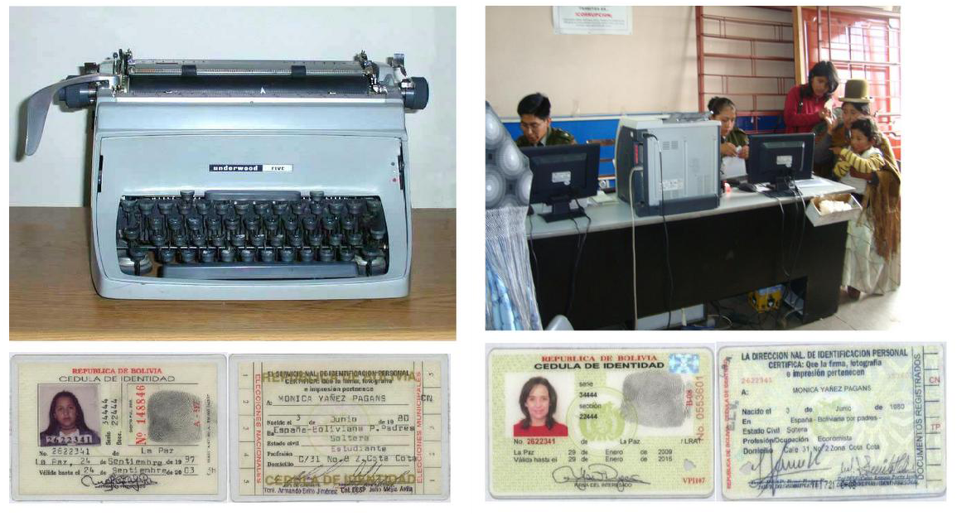
Government Efficiency and Computers in Bolivia
Use of ICT to improve efficiency in the issuance of national ID cards
Productivity of computer use (as opposed to typewriters) increases by more than one third
ICT cannot do it all: success rates of indigenous women is much lower –either because of discrimination, ignorance, or bureaucratic delay)

Slide 14
Lessons of Successful Cases

Slide 15
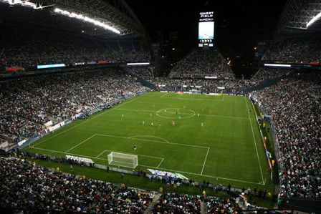
Do you Want to Win Soccer Games?

Slide 16
What we Learned
Access is different from Use
Resources are limited
Complementarities are crucial
Cooperation: Public-private partnerships

Slide 17
That’s why they work better in some areas than in others

Slide 18
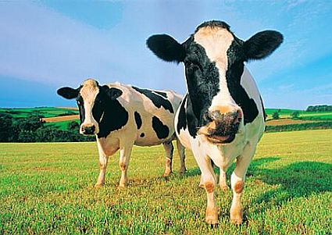
Do consider evaluation! (or the elephant -cow- in the room)

Slide 19
In summary,
The potential is there.
ICTs are not an end.
Not a silver bullet
Cost-benefit: Newer is not always better
Start small, evaluate, and then go big.

